Slide 1
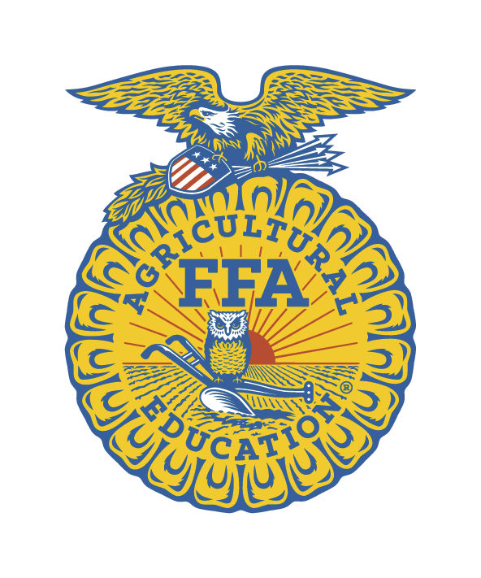
Agriculture Education & The National FFA Organization
Unit 1: Segment 1
History of the FFA & AGRICULTURE EDUCATION

Slide 2
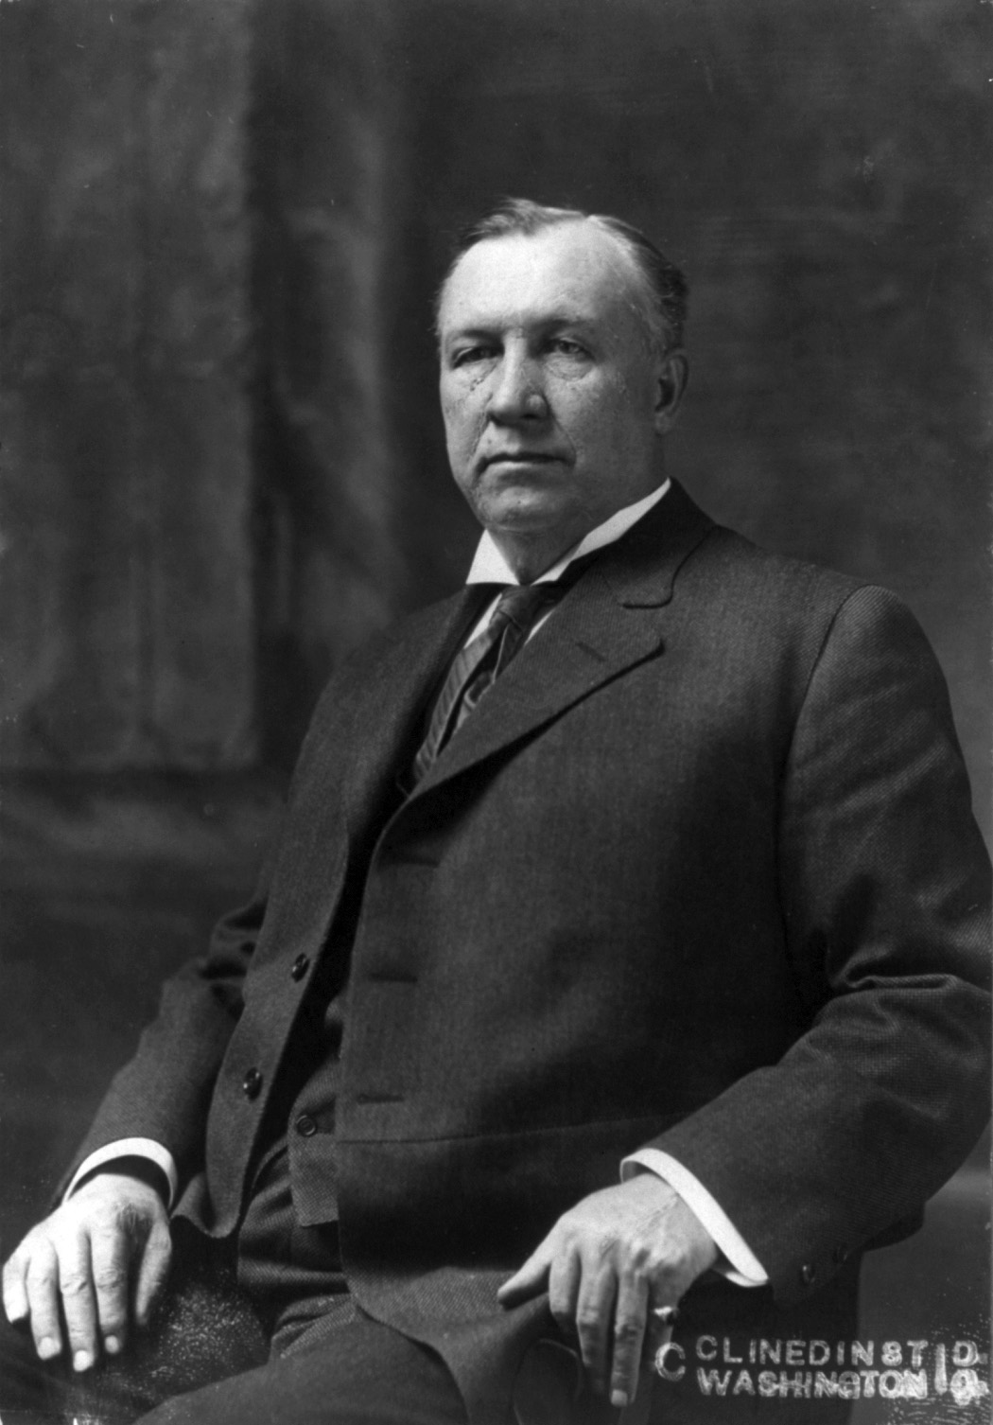
The Smith Hughes Act - 1917
Named after a senator from Georgia.
Provided federal funds to support vocational education in public high schools, including agriculture classes.
This legislation has supported the concept of providing students with a broad experiential base in preparation for employment.
Hoke Smith
Dudley Hughes

Slide 3
1920’s Future Farmer Clubs
Virginia was the first
Only males could join
No African Americans (or any other minorities)

Slide 4
The Future Farmers of America - 1928
FFA was established
The 1st Convention was held in the Hotel Baltimore in Kansas City, Missouri
The first dues were only 10 cents!

Slide 5
FFA History
1929
Official Colors Adopted – National Blue and Corn Gold
First FFA Manual is printed
1930
FFA Creed is written by E.M. Tiffany
1933
FFA Jacket was adopted as official dress

Slide 6
New Farmers of America - 1935
Organization for African-American males in high school agriculture classes
Colors: Black and Gold
Found mostly in Southern states

Slide 7
FFA History
1950
Public Law 740
Gave the FFA a Federal Charter
The law said that each school teaching agriculture must have an FFA program (Three Component Model)

Slide 8
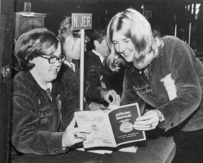
FFA History
1952
First issue of the National Future Farmer Magazine is published
1965
FFA and the NFA merge
1969
Females were admitted into the FFA

Slide 9
FFA History
1994
Future Farmers of America changes its name to the National FFA Organization
1989
National Future Farmer Magazine changes its name to FFA New Horizons

Slide 10
The FFA Mission
FFA makes a positive difference in the lives of students by developing their potential for premier leadership, personal growth, and career success through agricultural education.

Slide 11
The FFA Motto
Learning to Do
Doing to Learn
Earning to Live
Living to Serve

Slide 12
The FFA Emblem
Cross-Section Ear of Corn
A symbol of unity, corn can be found in every state across America. From the first Thanksgiving to a staple in American agriculture production, corn is a fundamental symbol of the National FFA.

Slide 13
The FFA Emblem
Rising Sun
This signifies progress. Just as agriculture continues to progress through new technologies and by responding to consumer demand, so must the National FFA Organization and its members.

Slide 14
The FFA Emblem
Plow
This simple image stands for so much more as it truly shows agriculture is the backbone of America. Our country and the National FFA are rooted in the labor and tillage of the soil.

Slide 15
The FFA Emblem
Owl
A symbol of knowledge and wisdom. It takes smarts to be successful in the agriculture industry today.

Slide 16
The FFA Emblem
Eagle
America is home to the free and brave, thus it is only fitting the National FFA Emblem include the eagle. The eagle is a national symbol that serves as a reminder of our freedom and ability to explore new horizons for the future of agriculture.

Slide 17
Agriculture Education & The National FFA Organization
Unit 1: Segment 2
Leadership

Slide 18
Challenge Yourself!
Develop college and career readiness skills.
Develop critical thinking skills & effective decision-making skills, foster teamwork, and promote communication.
Compete at the local, state, & national level!

Slide 19
What is the difference?
Career Development Events (CDE)
Leadership Development Events (LDE)
Poultry Evaluation
Agricultural Communications
Agricultural Sales
Veterinary Science
Agricultural Technology & Mechanical Systems
Environmental & Natural Resources
Farm & Agribusiness Management
Food Science & Technology
…and more!
Agricultural Issues Forum
Creed Speaking
Employment Skills
Extemporaneous Public Speaking
Prepared Public Speaking
Parliamentary Procedure
Conduct of Chapter Meetings

Slide 20
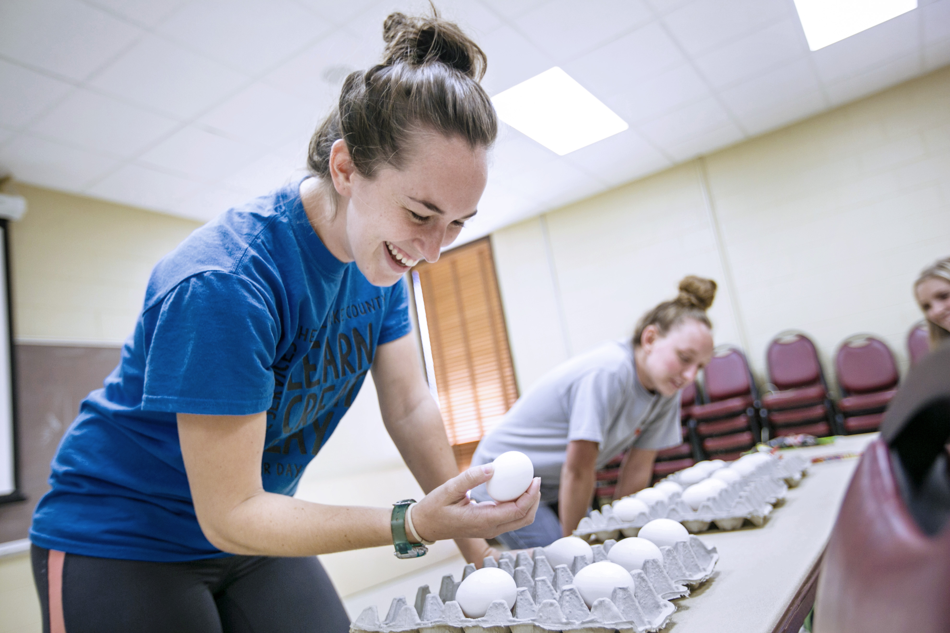
Fun Fowl Fact:
The Poultry Evaluation CDE was one of the five contests that preceded the founding of the National FFA Organization in 1928.
The first Poultry Evaluation CDE was held in 1926!

Slide 21
Agriculture Education & The National FFA Organization
Unit 1: Segment 2
Supervised Agricultural Experiences
& Agri-Science Projects

Slide 22
Supervised Agricultural Experience (SAE)
Foundational SAE
Career Exploration & Planning
Personal Financial Planning & Management
Workplace Safety
Employability Skills for College & Career Readiness
Agricultural Literacy
Immersion SAE
Entrepreneurship/Ownership
Placement/Interships
Research (Experimental, Analytical, Invention)
Agri-Science Project
School Business Enterprises
Service Learning

Slide 23
Agri-Science Fair Project
Poultry-Related Research Project
Research Examples
Experimental: Conduct a poultry feed experiment by comparing two types of feed and the impact of growth in a particular amount of time.
Analytical: Conducting a blind taste test of brown eggs and white eggs combined with a survey of consumer perception of the two.
Invention: Use your creativity to develop a new idea or invention that can improve a particular part of the poultry industry.

Slide 24
Poultry Science Curriculum References
Jessica Fife, UGA Dept. of Poultry Science Outreach Coordinator, UGA Dept. of Agricultural Leadership, Education, & Communication MAEE Candidate
Barry Croom, UGA Dept. of Agricultural Leadership, Education, & Communication Professor
Ashley Yopp, UGA Dept. of Agricultural Leadership, Education, & Communication Assistant Professor
Georgia Agriculture Education
Andrew Benson, UGA Dept. of Poultry Science Assistant Professor
Brian Jordan, UGA Dept. of Poultry Science Assistant Professor, UGA College of Veterinary Medicine Assistant Professor
University of Arkansas Bumpers College of Poultry Science – Poultry Science Dual Curriculum Course
Julia Gaskin, UGA Dept. of Crop and Soil Sciences Sr. Public Service Associate
Glendon Harris, UGA Dept. of Crop and Soil Sciences Professor & Extension Agronomist
Brian Kiepper, UGA Dept. of Poultry Science Associate Professor
Claudia Dunkley, UGA Dept. of Poultry Science Public Service Associate
Casey Ritz, UGA Dept. of Poultry Science Professor
USPOULTRY & USPOULTRY Poultry Science Curriculum
Tom Tabler, Mississippi State University Department of Poultry Science Extension Professor
Jacquie Jacob, University of Kentucky
Jeanna Wilson, UGA Dept. of Poultry Science Professor
Kelly Sweeney, UGA Dept. of Poultry Science Ph.D Candidate
Merck Veterinary Manual
University of Maryland Extension
Poultry Hub
Brian Fairchild, University of Georgia Department of Poultry Science Professor
Centers for Disease Control
National FFA Organization

